Slide 1
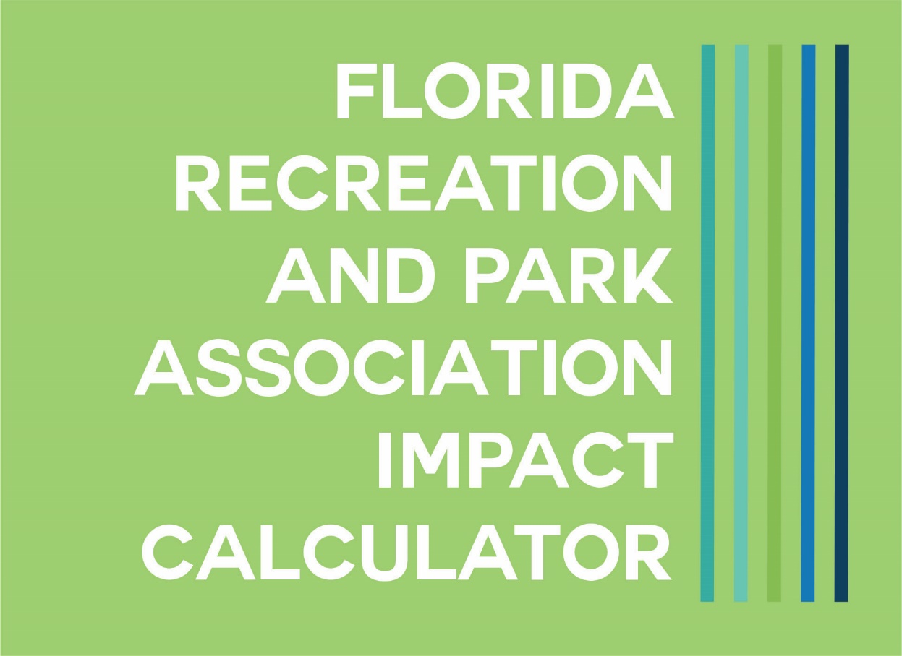
Please go ahead and Log into the Public WiFi

Slide 2
Welcome

Slide 3
How We Got Here

Slide 4
Conversation Began in 2009
Property Tax Roll Back
Economic Downturn
Local Governments Facing Draconian Budget Cuts

Slide 5
Strategic Plan Development
2015 - Called for a method of addressing the need to calculate the impact of parks and recreation
2016-17 – Conversations with funding partners – FRPA Foundation stepped forward to fund 50% of costs

Slide 6
Workgroup
Eric Call, Director Palm Beach County Parks and Recreation
Felicia Donnelly, Assistant City Manager, City of Oldsmar
Bryan Nipe, Director Lake Mary Parks and Recreation
T. Michael Stavres, Assistant City Manager, City of Winter Haven
Dr. Janet Fulton, Chief of the Physical Activity and Health Branch in the Division of Nutrition, Physical Activity and Obesity, at the Centers for Disease Control and Prevention
Dr. Tom Tomerlin, Economic Development and Strategic Initiatives Director, City of Maitland
Representatives of the State Department of Economic Opportunity
Staff of Sports Facilities Advisory

Slide 7
Goals Were Clear
Empower parks and recreation professionals to demonstrate the value of their parks;
Support community and decision makers’ engagement around the important of parks
Act in the best interest of parks and recreation professionals while providing a simple and impactful communication tool

Slide 8
What the Calculator Can’t Be
The only source of data and reporting of your parks system
The portrayal as an independent, peer-reviewed report
A replacement for the feasibility studies/reports/master plans that are vital to the growth and success of your system
A comparison to other parks/systems
Notes:
Econnect site where you can share reports.
If you have registered for the calculator you have been automatically added to this discussion group.

Slide 9
Before You Begin

Slide 10
Philosophical Decisions
What methodologies you will will apply to each of the areas so your agency is reporting in a standard method
There are calculations that allow you to override conservative figures
If you have more definitive local information that you believe is reliable, determine if you want to apply that in place of our calculations
Do you want information for individual parks/programs, or do you want to report as a whole system?

Slide 11
Information to Collect in Advance
Download the spreadsheet
Collect your information and record on the spreadsheet
Use the spreadsheet for quick data entry and results
Note: The last column “Annual Spending on Recreation and/or Events” is a calculation performed by the calculator tool as you enter. Once you see this calculation, record it in your spreadsheet as you will need this later on in another area of the calculator.
Notes:
Note: there are not any formulas in the spreadsheet; it’s simply to capture the info

Slide 12
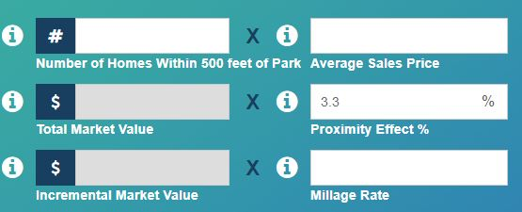
Helpful Hints
Google Chrome is the preferred browser for the best performance of the tool
Depending on which browser or screen size you’re using, the layout of the page may change
You can enter each of the six areas of impact by selecting the field from the top menu bar, or the bottom footer bar.
White fields are those in which you will enter information.
Grey fields are those where there is a resulting calculated value based on your entries.
Notes:
Grey fields cannot be changed – they are a result of a calculation.
White fields may have a default value or may indicate a field you need to enter a data point. Where there is a default value – if you have a better value based on local information, you can edit these values.

Slide 13
Helpful Hints
Information Points – hover over these to give you more information on the data point
Near the bottom of each page you can select the information point to take you to the research citations.
When you leave the calculator, the last entry you made will be retained – allows you to return to entry if interrupted.

Slide 14
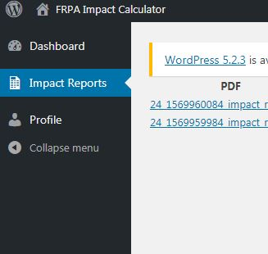
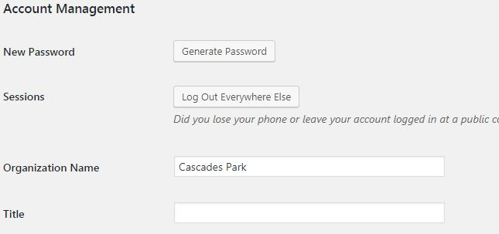
Your Profile
In far upper right corner, click on your agency name (this populates from our database).
If you want to change this to a specific park, select “Profile” on left menu bar.
Scroll until you see ACCOUNT MANAGEMENT, below this select Organization Name and change this to your individual park (this does not change anything in your FRPA member record).

Slide 15
Report Archives
Select your agency name from far upper right corner. You will see left menu bar on screen.
Select IMPACT REPORTS, and you can see the reports you have stored and what date those were recorded.
Click on the report you want to view as a pdf file.

Slide 16
Printing
Not recommended to print webpages as they are text heavy and are not formatted for final reporting
To print: select and at bottom of the Summary page select Generate Your Custom PDF Report Click Here
Notes:
Printing screen used only for reference if you’re going to create your own report.
Saving the pdf as the park name
List of pdfs

Slide 17
Clearing Your Values
To clear all of your past entries, go to the summary page, scroll down and select Clear All Values button

Slide 18
Let’s Get Calculating

Slide 19
Logging In
frpa.org/calculator
Click in the navy bar to enter the calculator site

Slide 20
First Time Users
Scroll to the bottom third where you see an area to login – DO NOT try to login
Select the Register option
You must be an FRPA member (individual)
Use your email on file with FRPA
Enter the Park Name you are registering for – this will appear on final reports but is changeable once your account is set up
Answer a few questions (first time only)
Click register – you will receive an email that provides approval and the next steps
Notes:
Demonstrate –

Slide 21
Returning Users
Click “Log-In” from the top right menu area - Enter your Email and Password
Note: If you forget your password, you can go back to Register and scroll down to Lost Your Password
You can enter the six areas of the calculator by selecting them from the top menu bar or the bottom footer bar
Notes:
Demonstrate
If LOG IN does not take you to the log in piece- scroll to the bottom third of the screen.

Slide 22
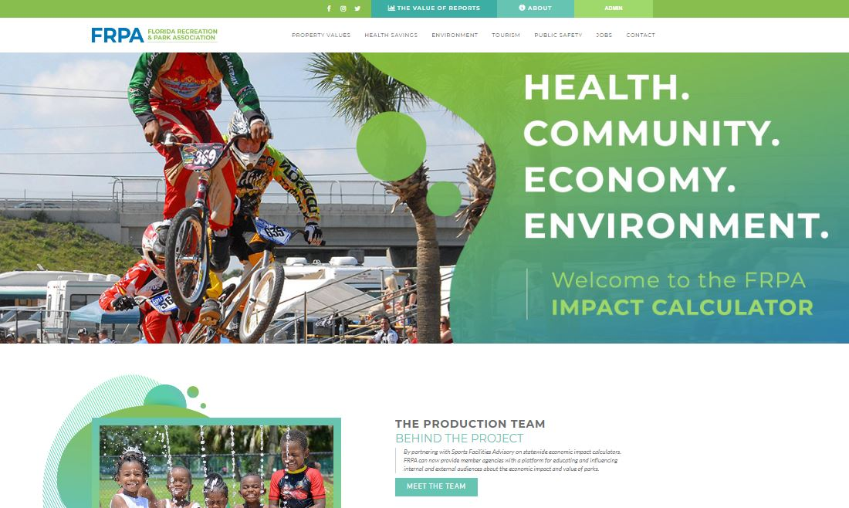
Layout of the Webpage
Notes:
review-
Top bar
Log in/profile button
FRPA logo-home
Links to calculators

Slide 24
Resources
Literature Reviewed – 23 studies
Selected 3
Mecklenburg County
Cleveland Metroparks
John Crompton’s Proximity Principle
Notes:
Citations are referenced on the bottom of each calculator page

Slide 25
Key Metrics
Proximity to a park improves home values
20% for homes adjacent to a park
10% for homes 1 block from park
5% for homes 2 blocks from park
Type of park impacts home values
10% for active recreation parks
33% for active and passive recreation areas within the park
70% for passive recreation within the park

Slide 26
Assumptions
We are calculating the value of the property to the owner
Apartments should be counted as one property
Condominiums that are individually owned should be counted per unit
If you are a county agency, you will want to use the appropriate millage for the location of the park so it can accurately express the value to the homeowner

Slide 27
Inputs
Number of houses
Decide which distance you want to use
Determine how to get information
Driving Count
Check with your planning department
Check with your property appraiser’s office
Google Maps
Average Sales Prices
We suggest you may want to contact a realtor or your local Board of Realtors
Check with your growth management department
Check with your planning department
Use Zillow.com or Realtor.com – CAUTION
KNOW YOUR NEIGHBORHOODS
Notes:
demonstrate sites where information can be found (google maps)
Demo entry

Slide 28
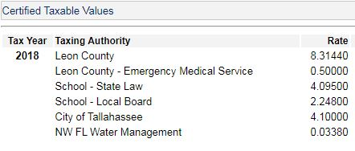
Millage Rate
The millage rate is the ad valorem tax on the value of a property and is levied by the governing authority of the jurisdiction in which the property is located.
Notes:
Example of finding Mileage: leon county property appraiser

Slide 29
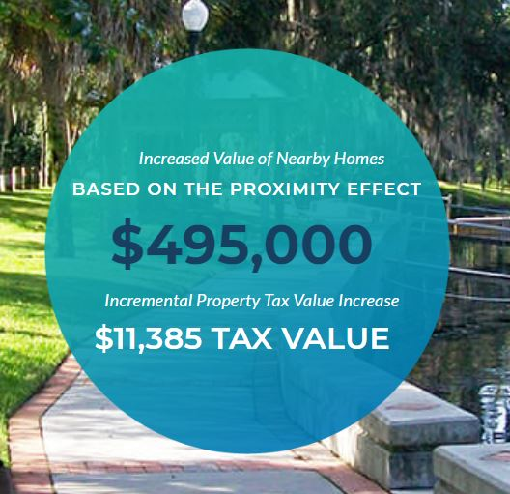
Results Provide
Increased value to nearby homes (aggregate)
Increased incremental value to your community

Slide 30
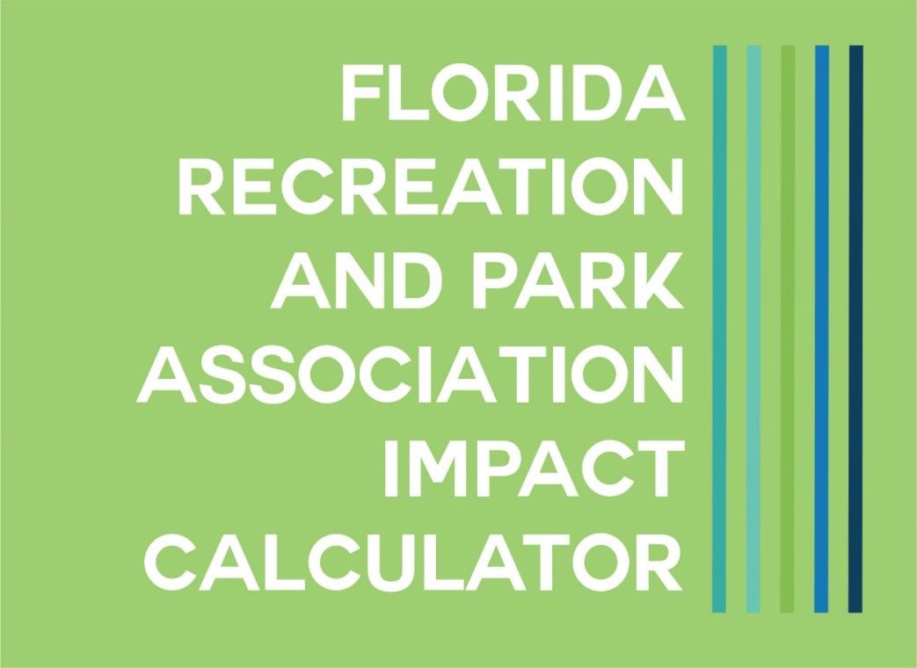

Slide 31
Resources
Literature Reviewed – 35 studies
Selected 2
Mecklenburg County
Cleveland Metroparks
Notes:
2019 Statewide Comprehensive Outdoor Recreation Plan
Regional Reports with information on activities conducted in parks
http://publicfiles.dep.state.fl.us/OPP%20Public%20Access/2019%20SCORP/SCORP%20Regional%20Reports%202019/

Slide 32
Key Metrics
Active adults under 65
Meet CDC guidelines of 150 minutes of moderate exercise a week
Active adults over 65
Meet CDC guidelines of 150 minutes of moderate exercise a week

Slide 33
Assumptions
You may want to collect this data over a period of time if you don’t have it
You may estimate – if so, you will want to state this in your presentation of the material
Notes:
Brainstorm how one may get this info

Slide 34
Inputs
# of unique users under 65 annually
# of unique users over 65 annually
Notes:
Demo entry

Slide 35
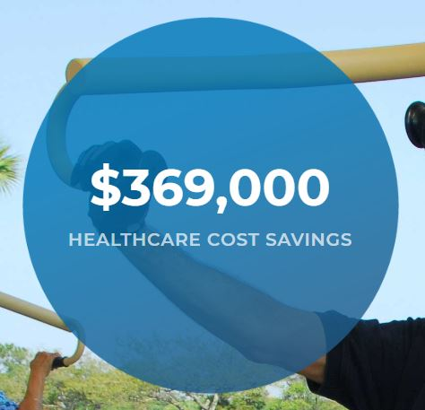
Results Provide
Estimated Annual Health Care Savings for Users Under 65
Estimated Annual Health Care Savings for Users Over 65
Healthcare Costs Savings Annually

Slide 37
Resources
Literature Reviewed – 20 studies
Selected 4
Urban Forestry Tree Guide – US Forest Service
STRATUM Climate Zones Map
Economic Benefits of the Park and Recreation System of Mecklenburg County, North Carolina – Trust for Public Land
Economic Benefits of Cleveland Metroparks – Trust for Public Land
Notes:
2019 Statewide Comprehensive Outdoor Recreation Plan
Regional Reports with information on projecting future attendance to report on impact
http://publicfiles.dep.state.fl.us/OPP%20Public%20Access/2019%20SCORP/SCORP%20Regional%20Reports%202019/

Slide 38
Key Metrics
$31-$39 average annual net savings from energy consumption, storm water management, air quality, and reduced CO2
Annual storm water mitigation and the resulting monetary savings
19,081 cubic feet of runoff avoided per acre of parkland
$.03-.05 per cubic foot of water avoided

Slide 39
Assumptions
Two ways to calculate impact in this area
Number of trees in the park
Total acres in the park

Slide 40
Inputs
Number of Trees
Tree inventories
Aerial estimation
Spot counts – take a small percentage of the acreage and count trees – apply that to the total park acreage.
Climate Zone – used only when calculating based on number of trees
Acres of parkland – should be readily available to you
Cost per Cubic Feet
$.03-$.05; usually $.04
Notes:
Brainstorm ways to get number of trees
Drones
Invoices form tree orders

Slide 41
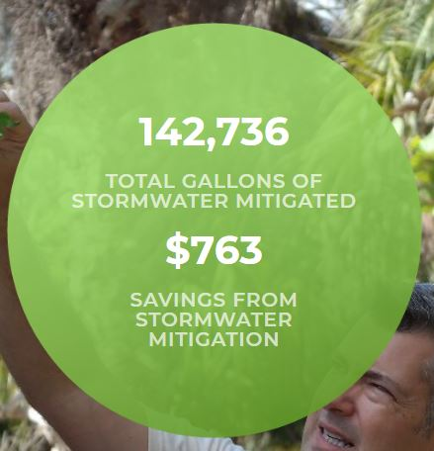
Results Provide
Number of Trees – Annual Net Savings from energy consumption, storm water management, air quality, and reduced CO2
Total Acres in Parks – Annual Savings in Stormwater Management costs

Slide 42
Back End Calculations
Back End Calculation for Total Acres in Parks
1 acre of land mitigates 19,081 cubic feet of water annually
1 cubic foot of water = 7.48052 gallons
Cubic feet is not a measure of volume – volume is measured in gallons – so we are converting cubic feet to gallons
Formula:
Total acres of parkland x 19,081 cubic feet = the total cubic feet handled by your park acreage
Total cubic feet handled by your park x 7.48052 = the total gallons of stormwater your park is mitigating annually

Slide 43
Back End Calculations
To assign a value to that stormwater, we must now convert the gallons back to cubic feet so you can apply the cost established in the research
Formula:
Divide the volume by cubic feet per gallon
Total gallons of stormwater your park is mitigating annually divided by 7.48052
Assign the cost savings – Total cubic feet x $.03-$.05

Slide 45
Resources
Literature Reviewed – 12 studies
Selected
Florida Department of Environmental Protection
Florida Sports Foundation

Slide 46
Key Metrics
Average number of park visitors who are non-local is 74% (this is for state parks)
Average daily expenditure for non-local visitors is $124.08 (this is for state parks)
Notes:
The % of avg number of visitors can be changed if you have a more localized percentage
Suggestion is to check with your local CVB or Sports Commission to see if they have a more localized average daily expenditure. If not, use the state park’s number

Slide 47
Assumptions
Non-local is defined as people traveling from 50 miles or more

Slide 48
Inputs
Total Visitors to Park for Recreation – self-directed activity, not in relation to an event or programmed activity.
% of non-local visitors – the default is 74% based on state park visitor surveys. If you have a more localized % from your own surveys or visitor’s bureau, use it.
Resulting Calculation of Non-local Visitors (Recreation) is the result of your entry for total visitors to the park for recreation multiplied by the % of non-local visitors.

Slide 49
Inputs
Total Visitors to Park for Events – visitors attending for programmed events. Not intended to capture pavilion rentals, etc. where there is no revenue beyond the rental fee.
% of non-local visitors - the default is 74% based on state park visitor surveys. If you have a more localized % from your own surveys or visitor’s bureau, use it.
Resulting Calculation of Non-Local Visitors (Events) is the result of your entry for total visitors to the park for events multiplied by the % of non-local visitors.
NOTE: The average expenditure is based on data from the 2016 Florida Visitor Survey by VISIT FLORIDA, stating visitor expenditures collected in Florida visitor surveys and studies show the average per person, per day expenditure is $124.08 (includes transportation, food [grocery and restaurant] and lodging).
Notes:
Or your economic development office

Slide 50
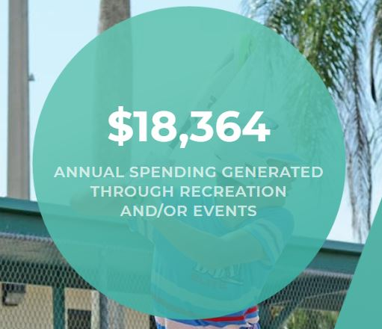
Results Provide
Average Expenditures by Total Visitors to the Park for Recreation
Average Expenditure by Total Visitors to the Park for Events
Annual Spending Generated Through Recreation and/or Events
NOTE: RECORD THIS IN YOUR SPREADSHEET AND SAVE FOR ENTRY IN THE JOBS AREA.

Slide 52
Resources
Literature Reviewed – 28 studies
Selected –
Out of School Time Programming – NRPA
Out of School Time Programming – North Carolina Central University
Drowning Prevention – CDC
Drowning Prevention – NRPA

Slide 53
Key Metrics
Students who do NOT participate in out of school time programs
57% more likely to drop out
49% more likely to use drugs
27% more likely to be arrested
Formal swim instructions/lessons (Age 1-4)
88% reduction in risk of drowning

Slide 54
Assumptions – Out of School Time
Out of school time programming includes after school, summer, holiday programming. You will want to state in your presentation which you have included.
Why we can’t assign a value?
Notes:
We have these research numbers but cannot assume that every child that is in our care will eventually go to jail or get in trouble of some kind. Using this research and other resources, you can communicate that the services provided to take care of children when they are not in school obviously directly relates to the chance that they are not going to be involved in criminal activity during those hours.
Additionally, the research that we refer to here only indicates that children ages 1-4 see a reduction in risk of drowning. You can assume that older children have a different reaction to falling in water, or, can stand up in smaller levels of water. On the reverse, you can assume that older children also tend to be more daring and take chances such as jumping in from unsafe places.
There is no direct research that says a certain program relates to how many children stay out of trouble.
Florida Afterschool Network study - https://floridacsc.maps.arcgis.com/apps/View/index.html?appid=e56f9d276e1041e98f526413f3bad8aa
http://www.myfan.org/state-of-afterschool-summer-learning-in-florida/

Slide 55
Assumptions – Swim Instruction/Water Safety
Research documents drowning risk reduction for ages 1 – 4 because beyond that, independent decision making can adversely affect the risk reduction.
Clearwater Lifeguard Story
https://www.youtube.com/watch?v=V4Y6q6V5X8w
We can’t assign a value, but we can tell a story.
Notes:
Clearwater Video

Slide 56
Inputs
Number of children in Out of School Time Programs
Number of children in Swim Lessons
Notes:
Use annual numbers
Use resources that provide local, positive stories from afterschool programs and swim lessons

Slide 57
Results Provided
Simple counts to start a conversation
Notes:
Use resources that provide local, positive stories from afterschool programs and swim lessons

Slide 59
Resources
Literature Reviewed – 2 studies
Selected
NRPA
Florida Department of Environmental Protection

Slide 60
Key Metrics
Every $120,220 spent in Total Economic Activity in Florida supports 1 job
Every $62,500 spent by visitors/tourists supports 1 job
Why Do We Say Jobs Supported vs Jobs Created?
Notes:
You may want to add to your conversation seasonal employees who would not be employed if a program was eliminated.
Also highlight the skill development that occurs with your counselors and other juvenile seasonal workers

Slide 61
Assumptions
Economic Activity is defined as the total operating and capital spending by local park agencies. Operating spending includes cost of salaries, wages and benefits. Capital spending includes costs of acquiring, upgrading, and maintaining park assets.
Should be specific to the park. If you don’t record your budget by park, consider the percentage of your total operating and capital budget that this park utilizes.

Slide 62
Inputs
Total operating and capital budget/spending by local park agency.
Total Annual Direct Spending on Recreation and/or Events (from Tourism calculator)

Slide 63
Calculation
The first calculation utilizes 2018 NRPA’s Economic Impact of Local parks study – data is Florida specific
Verify that the Total Annual Direct Spending on Recreation and/or Events is the correct amount that was generated on the Tourism tab
The second calculation utilizes the Florida Department of Environmental Protection study from 2017 which estimates total jobs supported through annual spending on recreation and/or events at parks.

Slide 64
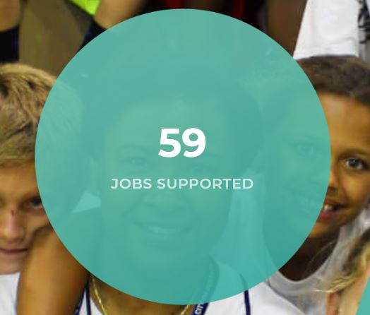
Results Provide
Jobs Supported by activities of your agency that generate revenue back to your community
Total jobs supported by your agency
Total jobs supported by recreation and events
Total number of jobs supported in the community

Slide 65
Importance of Reports

Slide 66
“Not everything that counts can be counted, and not everything that can be counted counts.” Albert Einstein
If stakeholders and decision-makers fail to see the value in parks, then there is no value.
Reporting should ensure that no one is unaware of the impacts that are delivered, not just provide an historical counting of participation.
If reports are difficult to assimilate, then reports are less likely to be created.
If there is no connection to a broader community context, then reports are not delivering comprehensive meaning.

Slide 67
The calculator report provides easy computation, graphically pleasing photographs, and speak about our impact in the bigger picture of property values, environmental savings, jobs supported, tourism, public safety and health.
The calculator reports are meant to capture impact, but more importantly to start a broader and deeper conversation with a variety of audiences.

Slide 68
Telling the Story

Slide 69
Where to Start
Proactive Approach – the instances where you have time to plan for the “story telling”
Look at your reports and identify compelling pieces of information
What makes it compelling – KNOW YOUR COMMUNITY
List target audiences appropriate for that information
Why would they be interested?
Identify your techniques
Know your audiences/target groups and create presentation to make that group activate or respond
Develop a plan for strategic outcomes
Evaluate and change for maximum impact

Slide 70
Where to Start
Reactive Approach – the instances where an immediate request occurs
Know your reports and the compelling pieces of information for all of your audiences
Develop your mantras – those things you can recite at the drop of a hat
Know your “adversaries” and have in your mind the story to react to their feedback
Create those consistent messages and assure all around you are speaking the same
Evaluate and change for maximum impact

Slide 71
Use Your Resources!
Articles
What Baltimore’s Plan to Redesign Waterfront means for Existing Communities (https://nextcity.org/daily/entry/what-baltimores-plan-to-redesign-its-waterfront-means-for-communities)
Nathan Benderson Park’s Economic Impact (https://www.heraldtribune.com/business/20191104/benderson-parks-economic-impact-hits-348-million)
Reports & Studies
SCORP Regional Reports (http://publicfiles.dep.state.fl.us/OPP Public Access/2019 SCORP/SCORP Regional Reports 2019/)
Landscape Performance Series (https://www.landscapeperformance.org/case-study-briefs)
Valuing the Flood Risk Reduction Benefits of Mangroves (https://www.conservationgateway.org/Pages/Florida-Mangroves.aspx)
FAN Study on Afterschool and Summer Camps (http://www.myfan.org/state-of-afterschool-summer-learning-in-florida/)
Notes:
Subscribe to different newsletters and tuck away interesting articles that may help you tell your story in the future. (Eclips)
Reports with indirect information may also help you build out a story
Studies done that may not be at your exact location can help support your story and ideas also
NEXT: It Starts in Parks

Slide 72
It Starts In Parks
Resources
Community Building
Health
Economic Impact
Environment
Notes:
Show them ISIP webpages with resources and messaging

Slide 73
What is Compelling to…
Elected Officials
City/County Management
Advisory Board Members
P&R Staff Members
Community Members
Homeowners Associations
Civic Organizations
Chamber of Commerce
Media
Notes:
Exercise – think of two things for each group that might make your report information compelling. Talk about it amongst your table

Slide 74
Methods of Communicating Results
Report Presentation (in person)
Annual Reports
Public TV Channels
Social Media Campaign – commemorative weeks/days
Website
Community Forums
Staff Trainings
Press Announcements
Inclusion in Your Planning Processes
Information to Your Stakeholders
Email Signature Lines
Event Announcements
Grand Openings
Notes:
Exercise – each group select one off the list
Develop a message using one of your results
Come back and present in ____ Minutes

Slide 75
Developing Your Plan
Consider forming an impact workgroup
Who do you need to reach (immediate need)
Who do you want to reach
Determine what impact area is appropriate for each audience
Determine whether you will use individual parks/programs, a regional approach, or a system wide report
Set a schedule for data collection
Identify stakeholders/audiences
Schedule implementation/presentations
Notes:
Need to reach
City Management – stakeholders example – finance department, police department, environmental services, etc…..
Want to reach
Citizens – stakeholders example – those who know about you, those that don’t know about you, your best advocates, your worst critics
What area is most appropriate – don’t overwhelm your groups with information they aren’t interested in – KNOW YOUR AUDIENCE – a presentation to a high school class won’t be the same as a presentation to your city commission.
Exercise – develop your personal plan – we know you may not have all the information (i.e. time it will take) but do your best
Selection one audience – either you need to reach or you want to reach and then construct a plan accordingly

Slide 76
Some good examples of story telling
Greenacres
https://www.youtube.com/watch?v=FWpwVspWjKw&feature=youtu.be
Pathway produces male role models for Greenacres youth
Notes:
Need to reach
City Management – stakeholders example – finance department, police department, environmental services, etc…..
Want to reach
Citizens – stakeholders example – those who know about you, those that don’t know about you, your best advocates, your worst critics
What area is most appropriate – don’t overwhelm your groups with information they aren’t interested in – KNOW YOUR AUDIENCE – a presentation to a high school class won’t be the same as a presentation to your city commission.
Exercise – develop your personal plan – we know you may not have all the information (i.e. time it will take) but do your best
Selection one audience – either you need to reach or you want to reach and then construct a plan accordingly

Slide 77
Some good examples of story telling
Palm Beach County Annual Report
“Citizen Involvement Volunteers saved taxpayers $3.7 million in 2017. More than 1500 permanent volunteers and 5000 special event volunteers contributed 153,417 service hours to support our programs and facilities, including 1,161 hours through our beach and park cleanup programs with more than 11,000 hours recorded and more than 100 cleanups by our Adopt A-Park volunteers.”
Notes:
Need to reach
City Management – stakeholders example – finance department, police department, environmental services, etc…..
Want to reach
Citizens – stakeholders example – those who know about you, those that don’t know about you, your best advocates, your worst critics
What area is most appropriate – don’t overwhelm your groups with information they aren’t interested in – KNOW YOUR AUDIENCE – a presentation to a high school class won’t be the same as a presentation to your city commission.
Exercise – develop your personal plan – we know you may not have all the information (i.e. time it will take) but do your best
Selection one audience – either you need to reach or you want to reach and then construct a plan accordingly

Slide 78
Some good examples of story telling
Hialeah Parks and Recreation Grant
youtube.com/watch?v=DCc-WfORNqg
NRPA Visit Park Sites in the City of Hialeah
Notes:
Need to reach
City Management – stakeholders example – finance department, police department, environmental services, etc…..
Want to reach
Citizens – stakeholders example – those who know about you, those that don’t know about you, your best advocates, your worst critics
What area is most appropriate – don’t overwhelm your groups with information they aren’t interested in – KNOW YOUR AUDIENCE – a presentation to a high school class won’t be the same as a presentation to your city commission.
Exercise – develop your personal plan – we know you may not have all the information (i.e. time it will take) but do your best
Selection one audience – either you need to reach or you want to reach and then construct a plan accordingly

Slide 79
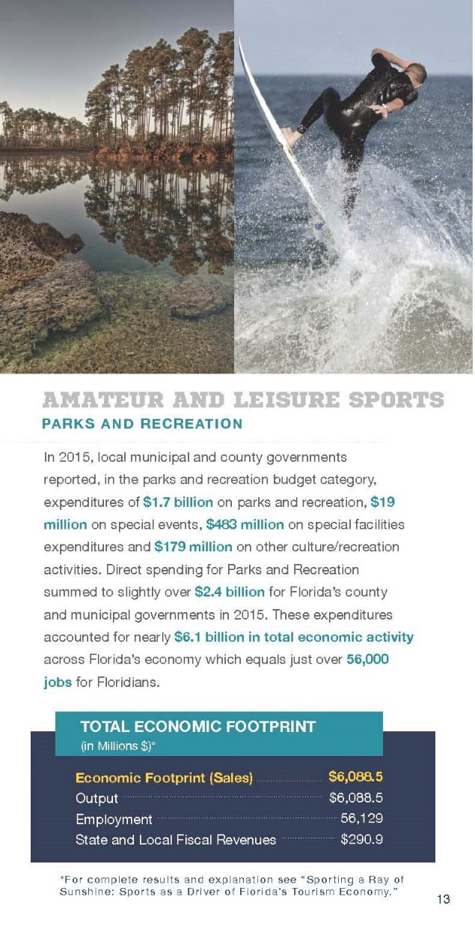
Florida Sports Foundation
The critical thing to remember is while it is nice to
have others tell your story, you can’t leave that
to chance. Ask others to tell it and then make
sure they are. Provide information to them that
is in keeping with your consistent message.

Slide 80
Thoughts Ideas Comments

Slide 81
We are always here to help you and answer questions

Slide 82
THANK YOU

