Slide 1
Creating Healthy Opportunities for Children
HEPA Summit 2015
John H. Armstrong, MD, FACS
State Surgeon General & Secretary
Florida Department of Health
Notes:
Good morning and thank you for having me here today!

Slide 2
917,400 jobs
#4 GDP in US; #19 in world

Slide 3
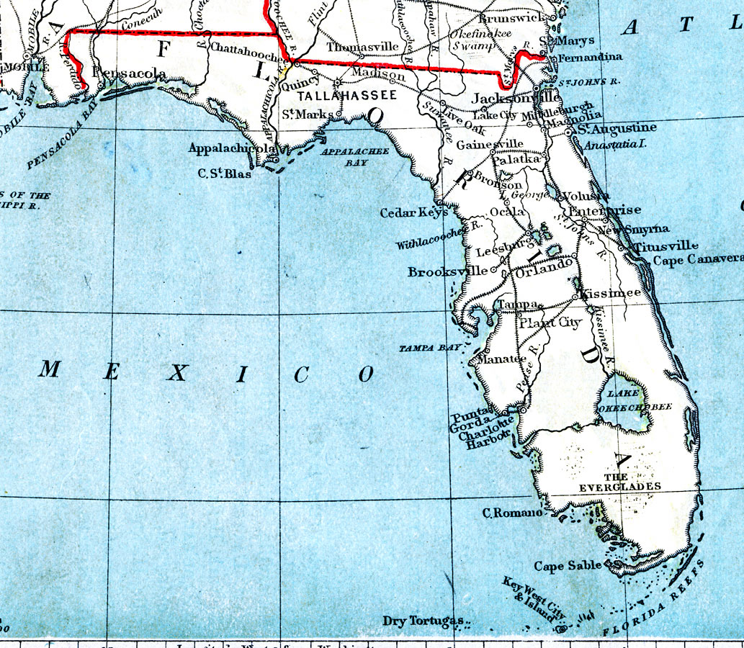
Florida 1889
270,000 residents
? visitors
38 yrs

Slide 4
Florida 2015
19.9 million residents
4.5 million children
79 years
Notes:
1200 miles of coastline (2nd behind Alaska)
800 miles from Pensacola to Key West
90% live in urban areas

Slide 5
Florida demographics
22% < 18
18% > 65
23% Hispanic
17% African American
Notes:
Transition: What attracts many of those residents and visitors to our state is its geographic diversity and beauty.

Slide 6
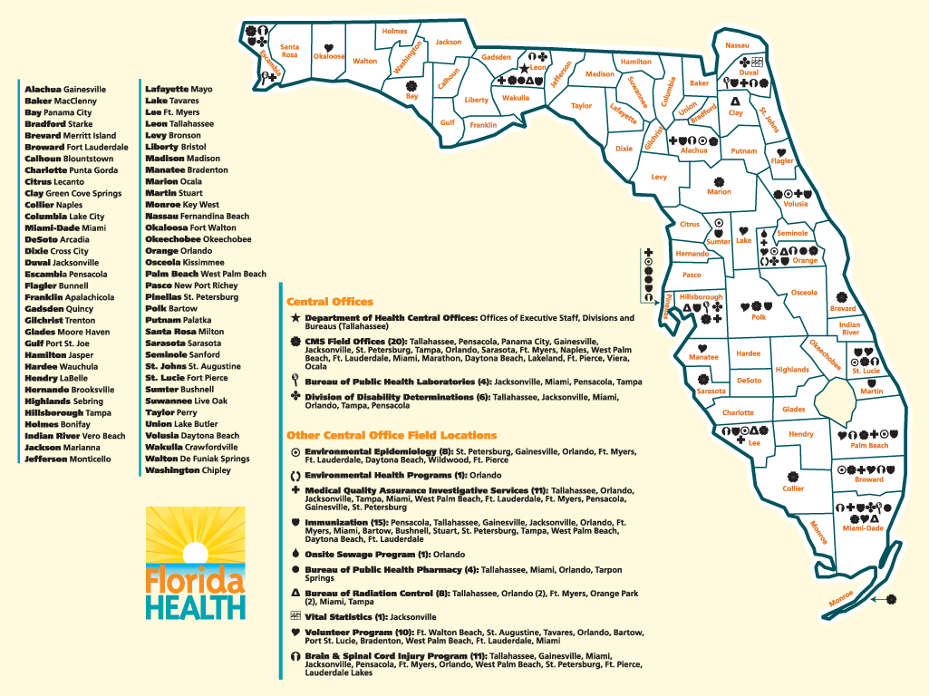
> 15 K employees
$2.9 B budget

Slide 7
Top causes of death
Heart disease
Cancer
Chronic lung disease
Stroke
Unintentional Injury

Slide 8
To extend life & improve quality of life

Slide 9
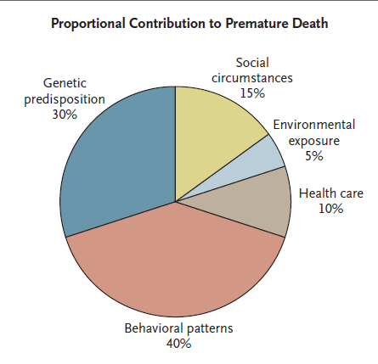
Determinants of health
Notes:
For 30 years people have been told to eat less and exercise, yet the obesity rate has tripled.
We have to get beyond just saying eat less and exercise more.
There is a flawed assumption that health is health care.
Stress the importance of health care professionals in molding behaviors.

Slide 10
Weight
35% 62.8%
Notes:
As we survey the health landscape, we see weight at the no.1 public health threat that challenges the bright future of Florida.
We know that people at an unhealthy weight live sicker and die younger and affect livelihoods that support Florida’s families.

Slide 12
Settings
Physical
Activity
School
Workplace
H
o
m
e
Food
&
beverage

Slide 13
2.1 million ages 10-18
Hours per week
592,200 weight challenged

Slide 14
Healthiest Weight Florida
Notes:
That is why your Department of Health launched Healthiest Weight Florida last year.
Healthiest Weight Florida is a public-private collaboration bringing together state agencies, local governments, businesses, schools, not-for-profit organizations, faith-based groups, health care professionals and entire communities to help Florida’s children, adults and families make consistent, informed choices about healthy eating and active living.

Slide 15
Empower Floridians to make healthy eating & active living the norm
Notes:
This is a call to action for families, communities and health professionals to work together to address the challenges facing our fastest growing demographic.

Slide 16
3 things today (& everyday)
Notes:
Three small steps anyone can take to make an immediate impact
Choose water instead of sugary carbonated beverages
Eat more fresh from Florida fruits and vegetables
Walk more by taking the stairs instead of the elevator

Slide 17
Healthy eating & physical activity standards
Notes:
This is a call to action for families, communities and health professionals to work together to address the challenges facing our fastest growing demographic.

Slide 18
HEPA standards
Beverages
Family engagement
Food
Infant feeding
Physical activity
Screen time
Notes:
The Healthy Eating and Physical Activity Standards help reshape classrooms and afterschool programs to promote healthy behaviors.
Teaching students about healthy lifestyles—including healthy eating and physical activity—at an early age helps today's students become healthy adults in the future.
Among the recommended standards:
Serving fruits and vegetables (fresh, frozen or canned) as options instead of cake, cookies, candy and chips .
Offering water as the preferred drink option during snack times instead of juices, punch boxes or soda.
Dedicating at least 20 percent or at least 30 minutes of morning or afterschool program time to physical activity (60 minutes for a full day program).
Ensuring that daily physical activity time includes aerobic and age-appropriate muscle and bone strengthening and cardio-respiratory fitness activities.

Slide 19
HEPA principles
All settings
Adult modeling
Age specificity
Repetition
Time awareness
Notes:
The Healthy Eating and Physical Activity Standards help reshape classrooms and afterschool programs to promote healthy behaviors.
Teaching students about healthy lifestyles—including healthy eating and physical activity—at an early age helps today's students become healthy adults in the future.
Among the recommended standards:
Serving fruits and vegetables (fresh, frozen or canned) as options instead of cake, cookies, candy and chips .
Offering water as the preferred drink option during snack times instead of juices, punch boxes or soda.
Dedicating at least 20 percent or at least 30 minutes of morning or afterschool program time to physical activity (60 minutes for a full day program).
Ensuring that daily physical activity time includes aerobic and age-appropriate muscle and bone strengthening and cardio-respiratory fitness activities.

Slide 20
www.HealthiestWeightFL.com
Notes:
Under the banner of Healthiest Weight Florida, we’ve initiated efforts across Florida to help create healthier environments for Florida’s children and families:
Health in all Places: the Health in All Places Tour is a chance for communities to come together to highlight what each coastal county has to offer when it comes to health.
Florida Walks: An interactive walking challenge designed to engage Florida's county leadership and county staff in physical activity (virtual 2,000 mile trek throughout Florida - from Pensacola to Key West).
Healthy Promise Florida: An interactive campaign promoting commitments to healthy choices during the New Year through physical and online message boards.
Ticket to Health: A catalogue of Florida's family-friendly attractions that help their guests eat smarter and move more.
Healthy Weight Community Champion Recognition Program: DOH recognized 65 communities as 2015 HW Community Champions for implementing policies and reshaping environments for healthier choices.
Breastfeeding Awareness Month and Baby-Friendly Hospitals: The Florida Department of Health has partnered with 27 Florida hospitals from 15 counties to participate in Healthiest Weight Florida’s Baby Steps to Baby Friendly Initiative.
These programs emphasize the value of approaching Healthiest Weight as a team sport.

Slide 23
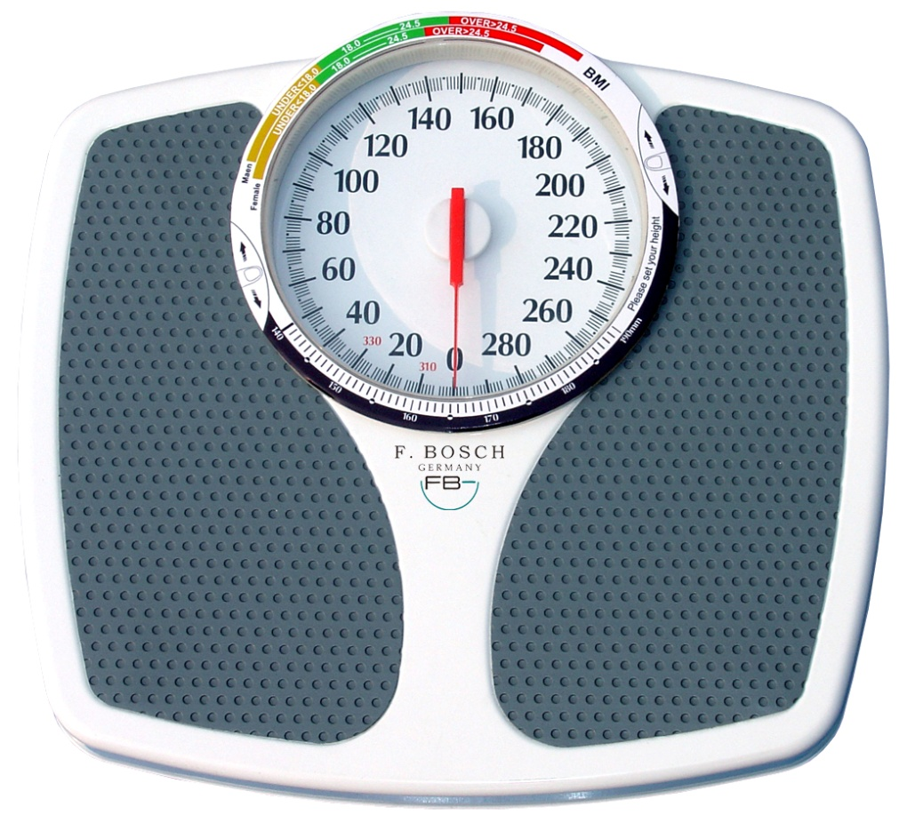
Measurement matters

Slide 24
From #19 to #14
Source: http://stateofobesity.org/states/fl/ (2014)
Notes:
Florida is a leader in the Southeast Region in terms of healthiest weight and is the only one in the region to have obesity rates less than 30%.

Slide 25
The best way to predict your future is to create it. Peter Drucker

