Slide 1
TJ Rutherford, Program Accountability Supervisor
Florida Department of Agriculture and Consumer Services- Division of Food, Nutrition and Wellness

Slide 2
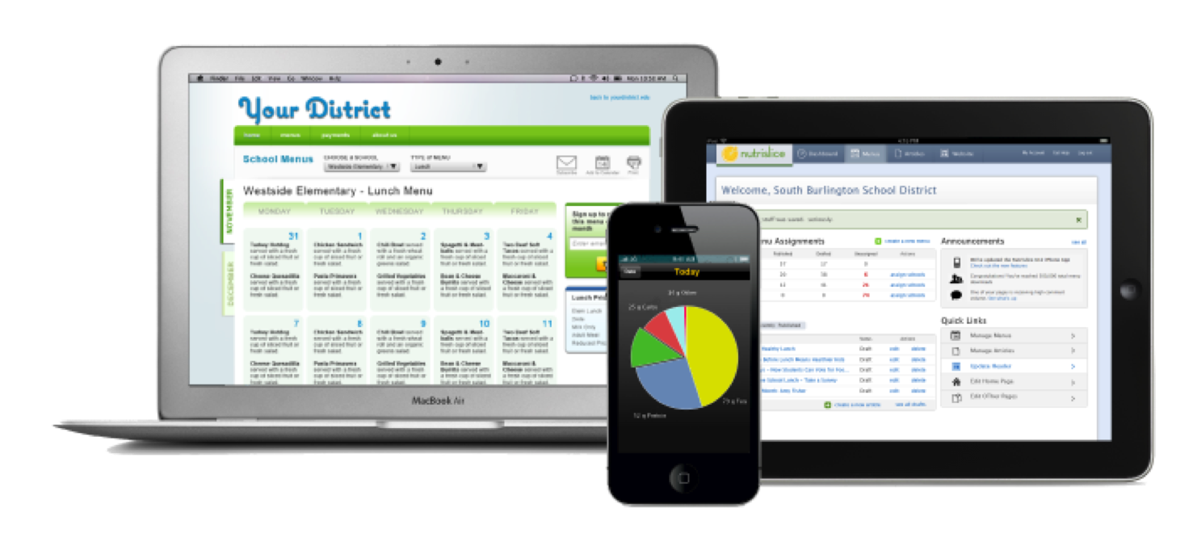
Download our app today: search for “Nutrislice”
Nutrislice Menus
Beautiful, easy to use school menus

Slide 3
Living Healthy in Florida
Notes:
Food Access Mapping Project
GIS Mapping of all food insecurity indicators and food access assets throughout the State, including:
Federally-Qualified, Free, and County Health Clinics
Farmers Markets
Food Banks
Food Pantries & Soup Kitchens
Title I/Failing Schools
Child Nutrition Programs
Senior Feeding Programs
Asset data is layered over food desert census tracts with the highest diabetes death rates and highest number of Supplemental Nutrition Assistance Program (SNAP) eligible households with children and seniors
0

Slide 4
Florida Farm to School
Notes:
The Florida Farm to School initiative is no different that of the federal efforts. The mission for the Florida Farm to School program is to increase the volume of fresh and nutritious Florida products offered in the schools and to promote opportunities for schools and local farmers to work together. Farm to School programs exist throughout Florida in school districts of all sizes – large and small, rural and urban alike. Sponsors who participate on the National School Lunch Program are encouraged to work with the Florida Department of Agriculture and Consumer Services when deciding to implement or expand farm to school efforts. Let’s take a further look at what is happening in the state.

